Slide 1
Movie recommendation system
Andrii Chornyi & Adam Kubicki

Slide 2
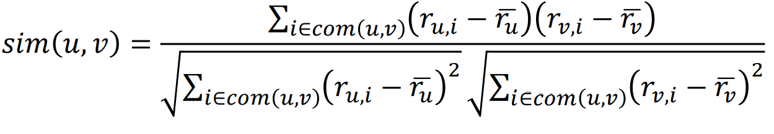
Recommendation engine system formula Collaborative filtering

Slide 3
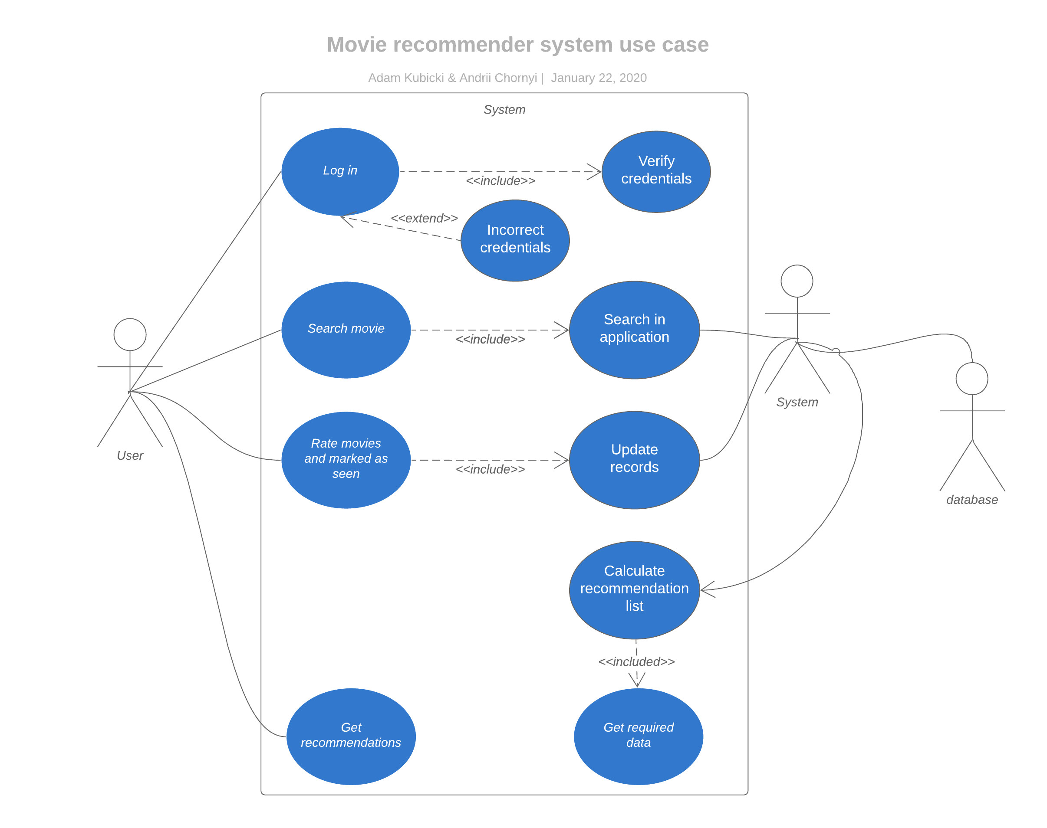
Uml diagram use case

Slide 4
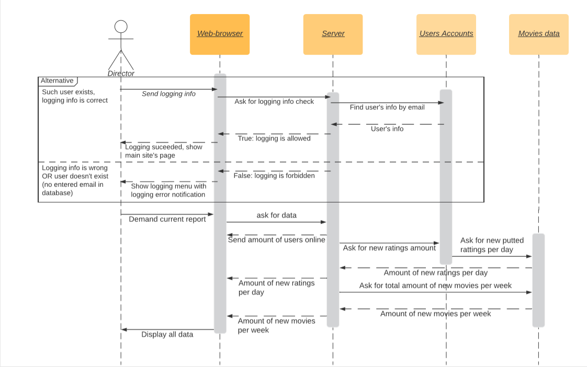
Uml diagram Sequence

Slide 5
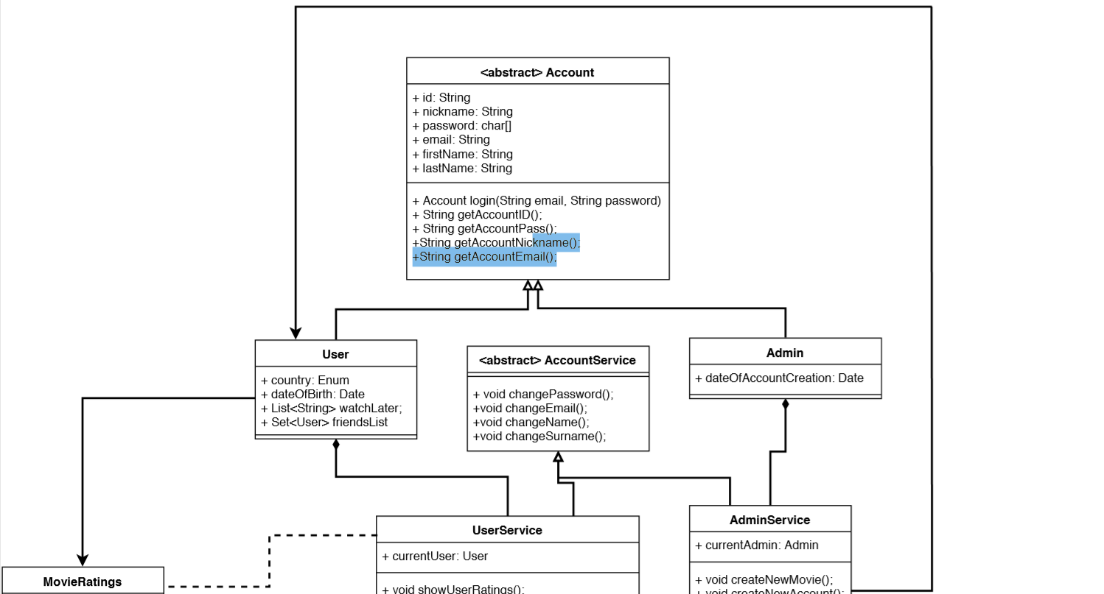
Uml diagram Class part 1

Slide 6
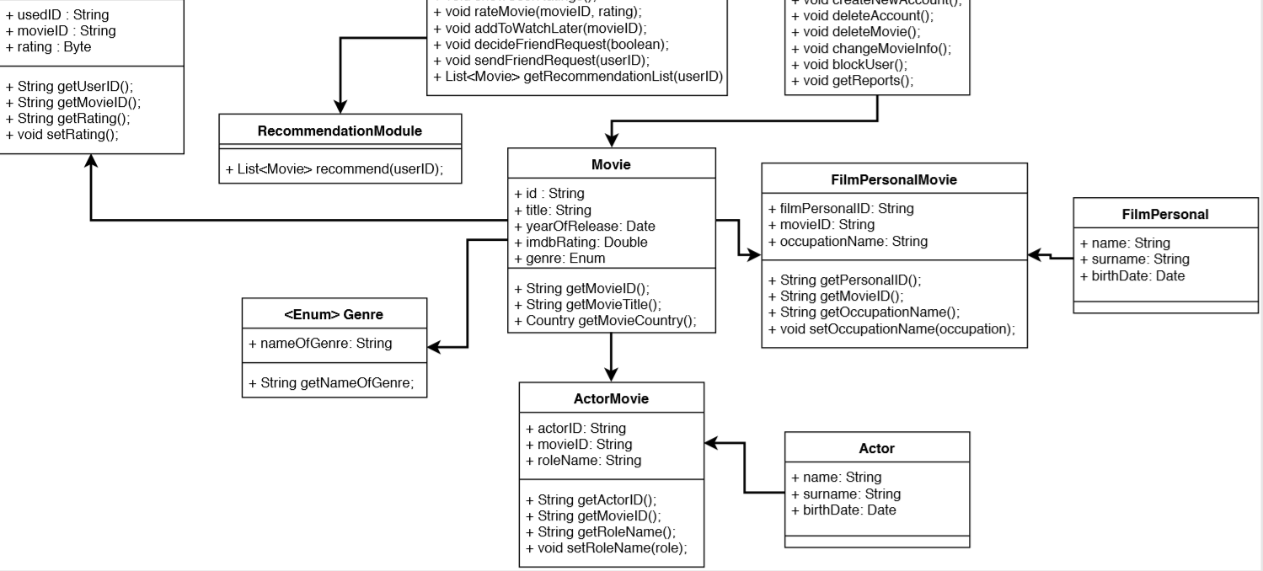
Uml diagram Class part 1

Slide 7
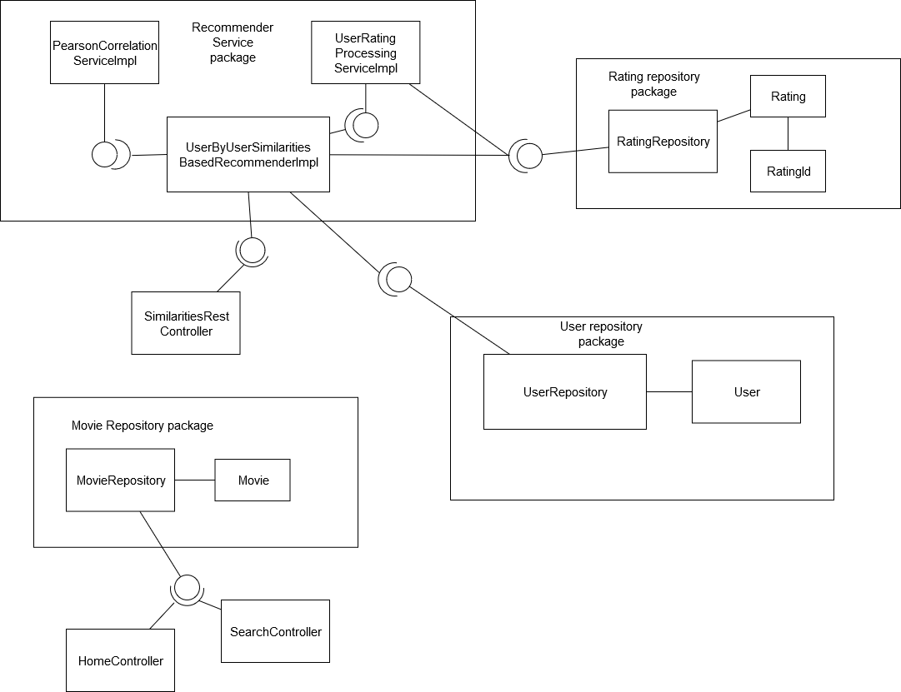
Component diagram

Slide 8
Software package metrics

